Slide 1


What Food Can Tell Us
Speaker: Zhang Han
An Appreciation of
EE0005 mini project 2020
Notes:
Welcome to our group's mini project presentation, I'm Zhang Han. Our topic is an application of what food can tell us, which is based on the what’s cooking dataset.

Slide 2
Outline:
Zhang Han
1
Project allocation
2
Our objectives and the type of ML used to solve it
3
Basic exploration and data visualization
4
Objective 1
5
Objective 2
Notes:
This is the outline of our presentation, which contains 5 parts.

Slide 3

Project allocation
Zhang Han
1. Basic exploration (Vincentius Dennis Herell)
2. Data visualization:
a. the first three data visualizations (Vincentius Dennis Herell)
b. the last three data visualizations
(Zhang Han)
3. Objective 1 (Zhang Han)
4. Objective 2 (Vincentius Dennis Herell)
5. Code integration (Zhang Han)
Notes:
First, for the project allocation of our group, it is shown in the slide. My partner is responsible for the basic exploration, the first three data visualizations and objective 2. I'm mainly responsible for the last three data visualizations, objective 1 and code integration.

Slide 4

Our objectives and the type of ML used to solve it
Zhang Han
1. Objective 1:
Determining, using clustering, if similar cuisines are also geographically close to each other
2. Objective 2:
Predicting, using classification, the cuisine a dish belongs to
Notes:
Now, let's move to the next part. the what's cooking data provides us a table of cuisines with many dishes and the specific ingredients included in each of them.
Many food critics agree that ingredients are often associated with a cuisine as a result of geographical circumstance, cultural history, or both. So we want to explore the cooking culture behind the what's cooking data. That’s the first objective: determining if similar cuisines are also geographically close to each other using clustering. Clustering can divide the cuisines into few groups according to the similarities of their ingredients. Then from the geographical location of the cuisines in each cluster, we can draw the conclusion.
What's more, if there is the kind of cooking culture that a certain cuisine means high possibilities of some dishes and low possibilities of some other dishes, it's likely to realize our objective 2 using classification. classification can predict which cuisine a dish belongs to with the feedback of the prediction accuracy.
Next, I’ll pass to my partner to present.

Slide 5

Basic exploration and data visualization
Speaker: Vincentius Dennis Herell
1. Basic exploration
a. Reading the file
2. Data visualization
a. Number of recipes for each cuisine
b. Recipe length distribution
c. Top 20 ingredients
d. Number of unique ingredients used only in each cuisine
Notes:
Hi! I’m Dennis and I’m going to present to you the dataset that we use in this project
(there are 6 data visualization pictures in total but because of the time limit, only 4 are presented here)

Slide 6
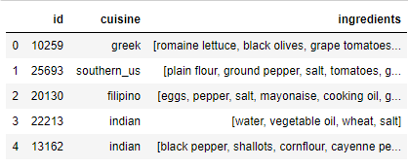
Reading the file
Vincentius Dennis Herell
3 Column: id, cuisine, and ingredients
Total of 39774 recipes, 20 Country Cuisines, and 6714 ingredients
Notes:
Just by brielfly seeing it, we can see that the dataset consist of 3 column. An id for each recipe, which cuisine the dish belong to, and the ingredients of the dish in list format. Exploring further, we know that this dataset consist of more than 39000 recipes with no Null value. There are 20 country cuisines, and a more than 6000 different ingredients.

Slide 7
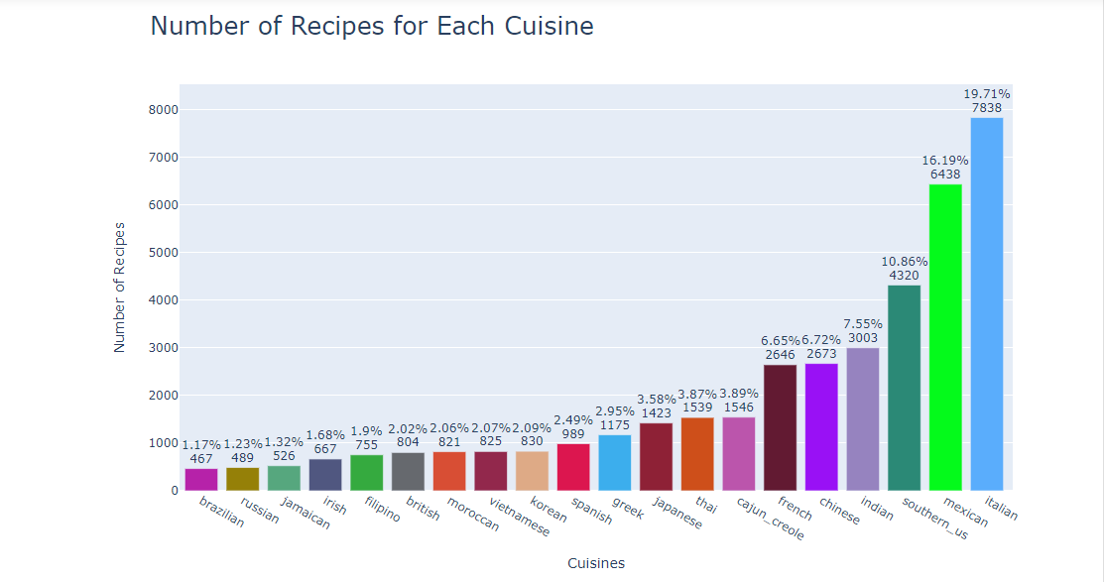
Vincentius Dennis Herell
Notes:
To give a better visualization of the dataset, we’ve created a graph of the number of recipes for each cuisine. Here, we can see that most of the dish are Mexican and Italian.

Slide 8
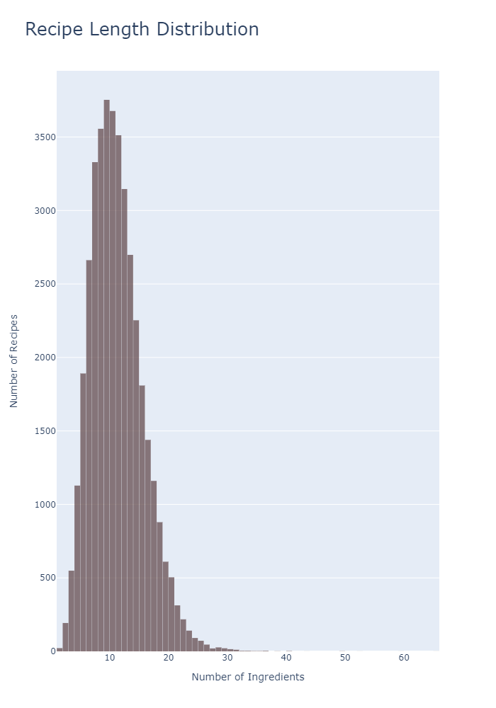
Recipe Length Distribution
Vincentius Dennis Herell
Notes:
Next, we have the distribution of the recipe length. We can see that most of the recipes consist of about 10 different ingredients.

Slide 9
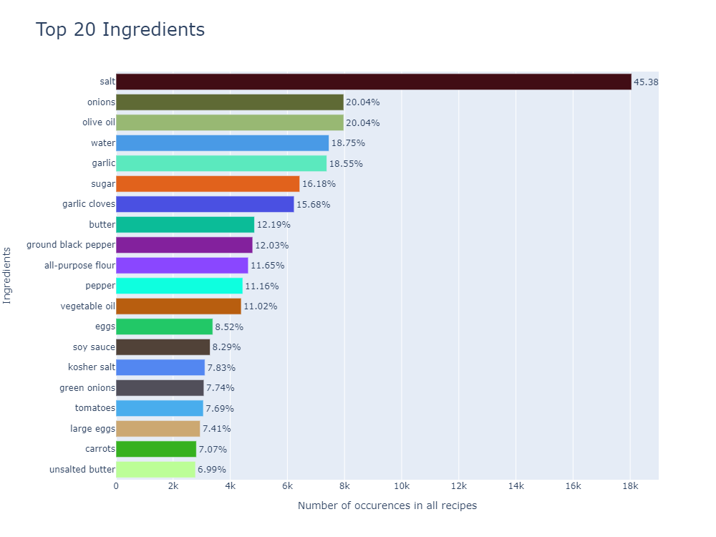
Vincentius Dennis Herell
Notes:
Another important things we want to know, are the common ingredients in all recipes. These are the ingredients that will not really help with our objectives of clustering and classification.

Slide 10
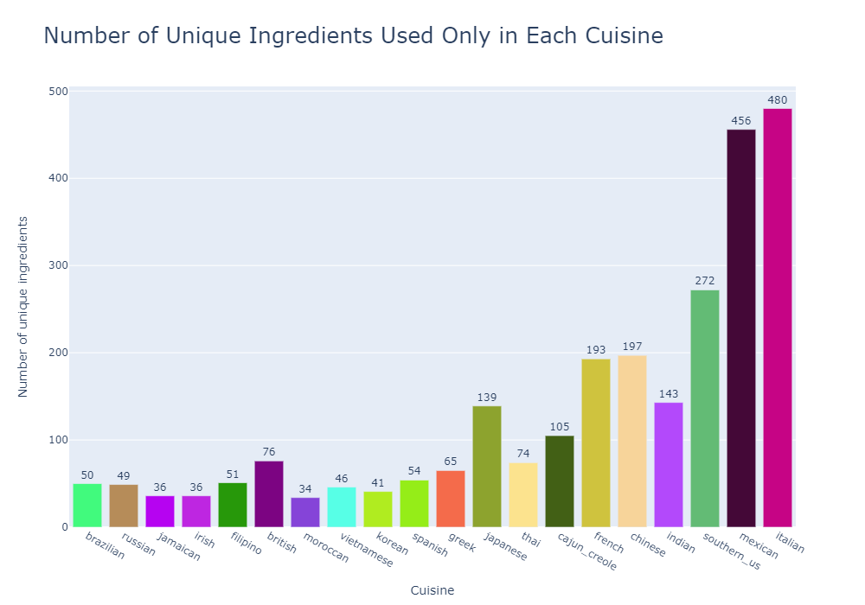
Vincentius Dennis Herell
Notes:
So, after putting out all the common ingredients. We have here, the number of unique ingredients used only in each cuisine. From this graph, we can see which cuisine we will be more likely able to predict. Those with more unique ingredients should be more easily classified. That’s a brief view of the dataset we are using, next my partner will start explaining about using clustering to achieve our objective.

Slide 11

Objective 1: clustering
Zhang Han
To determine if similar cuisines are also geographically close to each other based on the ingredients and geographical location of each unique cuisine
Notes:
Now let me talk further about how to realize the first objective.

Slide 12

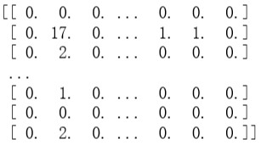
a. Data preparation—3 steps
Zhang Han
The original list of cuisines with their ingredients to a new 20*6714 list
A row– one cuisine
A column– one kind of ingredient
Entries of the matrix– the number of dishes containing the specific ingredient in this cuisine
Notes:
The data is given as a list of cuisines with their ingredients. We can't directly use it for clustering, so there are three steps of data preparation.
First, convert it from the original list to a new list, the entries of which shows the number of dishes containing the specific ingredient in the cuisine, that is, the count of numbers of each ingredients in every cuisine.
Then, calculate the term frequency- inverse term frequency of the matrix, which shows the importance of a specific ingredient.
Last, use the principal component analysis to get a table of 2D coordinates of each cuisine. The 2D coordinates are what we used for clustering

Slide 13
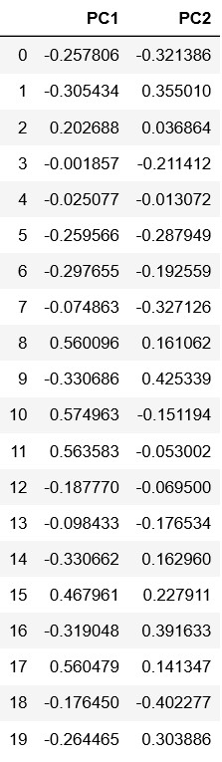
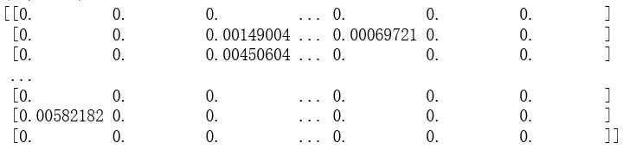
The new 20*6714 list to the tfidf matrix
The tfidf matrix to a table of 2D coordinates of each cuisine
Using the principal component analysis (PCA).
Converted the matrix to a 2D coordinates table, making it more suitable for clustering
Compute the term frequency - inverse document frequency of the ingredients in each cuisine, which shows the importance of a specific ingredient
Notes:
Then, calculate the term frequency- inverse term frequency of the matrix, which shows the importance of a specific ingredient.
Last, use the principal component analysis to get a table of 2D coordinates of each cuisine. The 2D coordinates are what we used for clustering

Slide 14
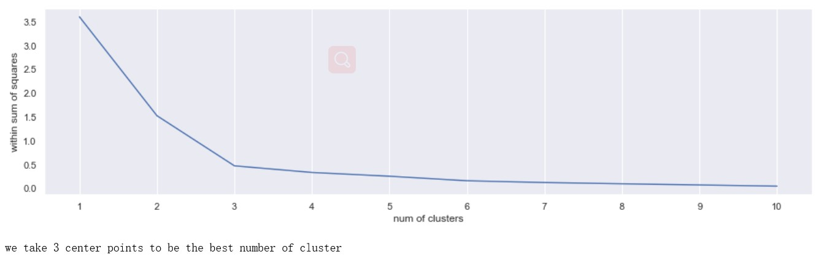
b. Techniques used in solving the problem
Zhang Han
Main technique: KMeans++ Clustering
Compute the within sum of squares vs the number of clusters to determine the appropriate number for our KMean++ Clustering
Notes:
For the clustering process, a suitable number of clusters is import. So we compute the within sum of squares at each assumed number of clusters. As shown in the picture, 3 is a suitable number.

Slide 15
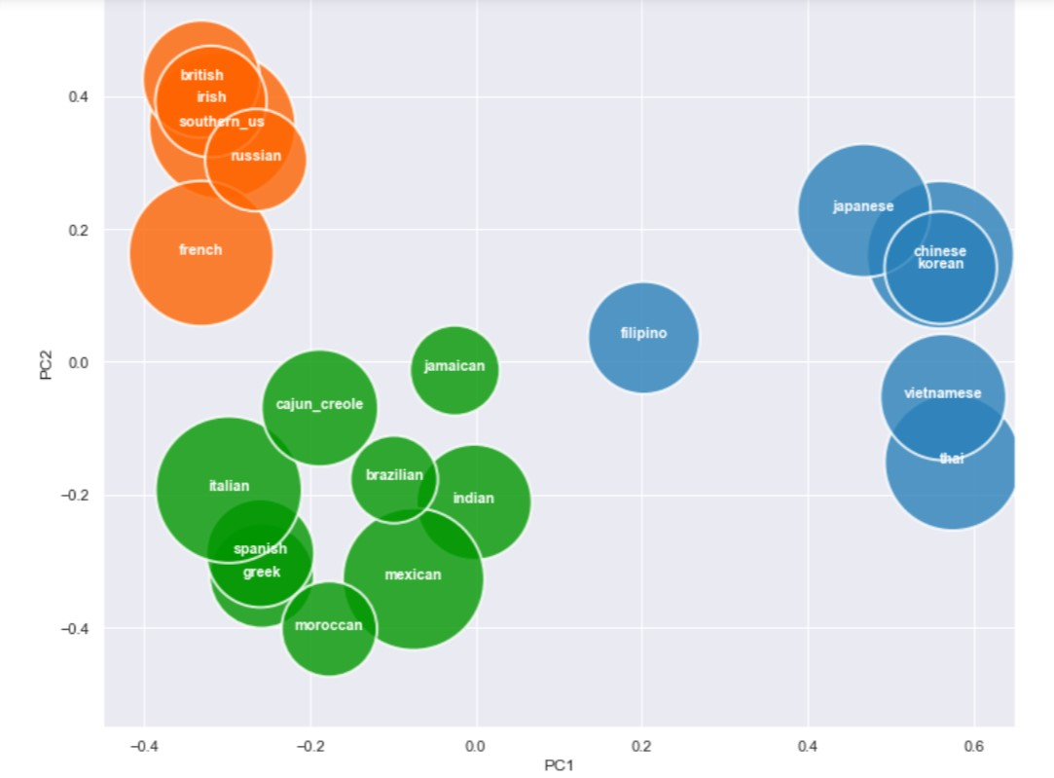
Zhang Han
KMeans++ clustering
Cluster all the unique cuisines into 3 groups and label them
Notes:
So we applied the kmeans++ clustering method to get 3 groups of cuisines, label and show them as below. The area of the bubbles represents the number of ingredients in a cuisine and the overlapping of bubbles shows the similarities between cuisines. However, it is only based on the ingredients.

Slide 16
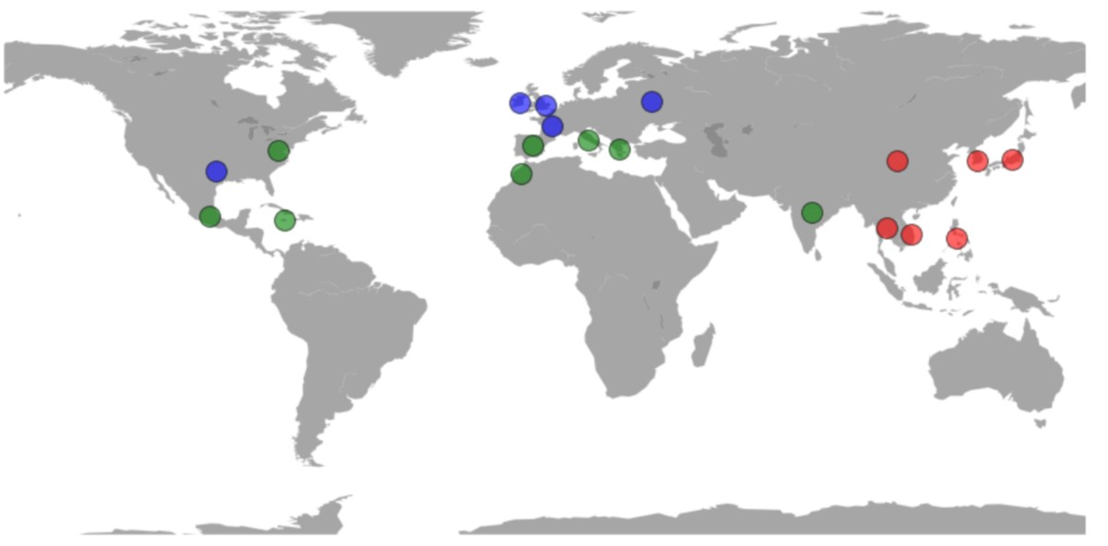
Zhang Han
Mapping
Show the clustering results on the world map

Slide 17
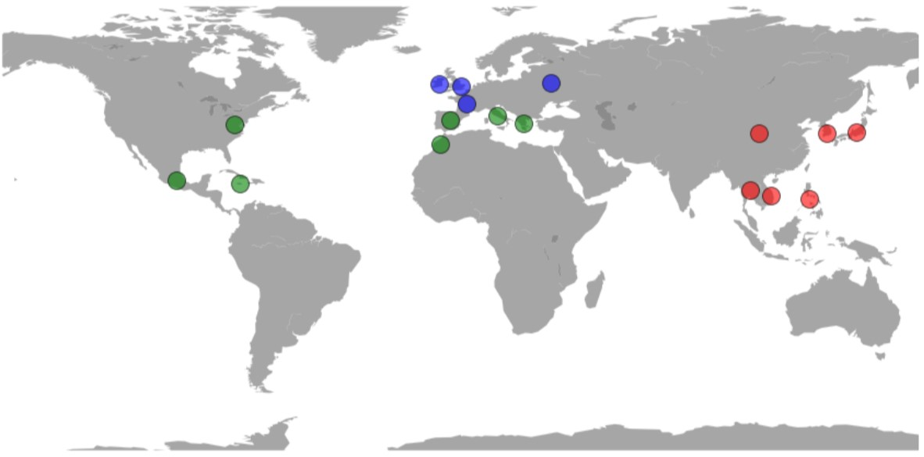
Zhang Han
Removing anomalies
Notes:
After removing the anomalies, there are still 90% of the cuisines exists and we get the following map. It perfectly fits our assumptions.

Slide 18
c. Outcomes and conclusion of objective 1
Zhang Han
Although there are multiple factors affecting the cooking culture of a cuisine, in general, one can say that similar cuisines are also likely to be geographically close to each other.
Notes:
Therefore, the conclusion is drawn. Although there are multiple factors affecting the cooking culture of a cuisine, in general, one can say that similar cuisines are also likely to be geographically close to each other.

Slide 19
d. Tools and techniques beyond the course
Zhang Han
Sparse matrix
Term frequency - inverse document frequency
PCA
Plotting using Basemap and pylab
Notes:
This objective is not only very interesting to me, but also makes me learn lots of things to realize it better, such as how to use PCA, sparse matrix, term frequency - inverse document frequency and how to plot a better picture using basemap and pylab.
That's all for objective 1.
Now, let my partner to present the following objective.

Slide 20

Objective 2: classification
Vincentius Dennis Herell
To predict which cuisine the dish belong to based on list of ingredients given.
Notes:
We have come to the second objective, that is: to predict which cuisine the dish belong to based on ingredients given. To do that, we are using classification model.

Slide 21
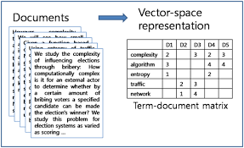
Term Frequency - Inverse Document Frequency
Vincentius Dennis Herell
To prepare the data for classification, we use TF-IDF vectorizer to give a ‘score’ to each word. This score determine how important each ingredients will be.
https://www.quora.com/What-is-a-tf-idf-vector
Notes:
First, as with clustering. To use the data, we use TF-IDF vectorizer to give weight to each words, each ingredients.

Slide 22
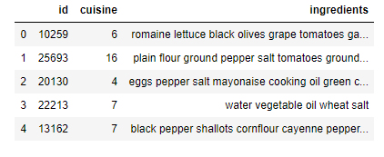
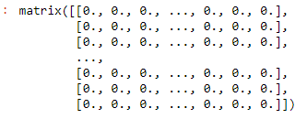
Machine Learning Model
Notes:
To do that, first we convert the ingredients from a list into one whole text. We use tf-idf vectorizer from scikit and got a result in the form of a matrix. This matrix consist of a vector for all the recipes. Each vector has more than 3000 value to account for all the different words that contain different weight. This is the input for machine learning model.

Slide 23
Classification Models
Vincentius Dennis Herell
Decision Tree Classifier
Random Forest
Linear SVC
Logistic Regression
Multinomial Naive Bayes
Voting Classifier
Notes:
There are 6 Classification models that we are using. Initially, we don’t know which model will perform the best as it also depend on the data.

Slide 24
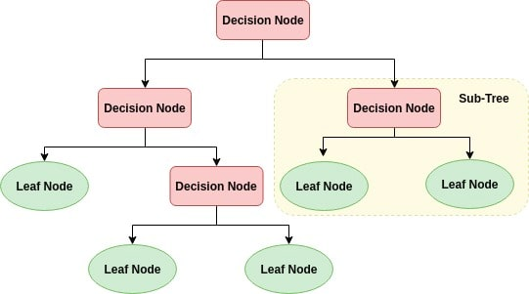
Decision Tree Classifier
https://www.datacamp.com/community/tutorials/decision-tree-classification-python
Notes:
First, is the Decision Tree Classifier that we have learned in class.

Slide 25

Random Forest Classifier
https://medium.com/@williamkoehrsen/random-forest-simple-explanation-377895a60d2d
Notes:
Next, we use Random Forest classifier, which is basically many decision tree ran from a randomly selected features, and then averages the result.

Slide 26
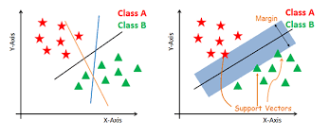
Linear SVC
https://www.datacamp.com/community/tutorials/svm-classification-scikit-learn-python
Notes:
Third, we use linear support vector classifier, which basically using this picture, create a line that separate between the two classes. But instead of only two y & x axis, we have more than 3000 features, and instead of a line, we have hyperplanes

Slide 27
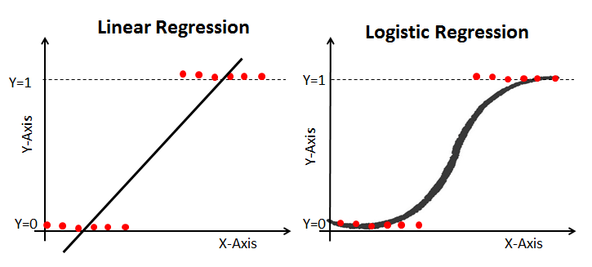
Logistic Regression
https://www.datacamp.com/community/tutorials/understanding-logistic-regression-python
Notes:
Fourth, we use logistic regression. Logistic regression is somewhat similar to linear regression, except it give a binary result rather than continuous- and instead of fitting a line, logistic regression fit an s shaped logistic function. Thus it is useful as a classification model.

Slide 28
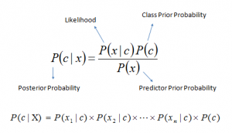
Multinomial Naïve Bayes
https://www.analyticsvidhya.com/blog/2017/09/naive-bayes-explained/
Notes:
And then, we use the Multinomial Naïve Bayes model, which use probability theory and calculate the most probable cuisine the dish belong to.

Slide 29
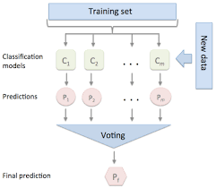
Voting Classifier
https://medium.com/@sanchitamangale12/voting-classifier-1be10db6d7a5
Notes:
Finally, we use voting classifier which integrate the result of the other models as our final model.

Slide 30
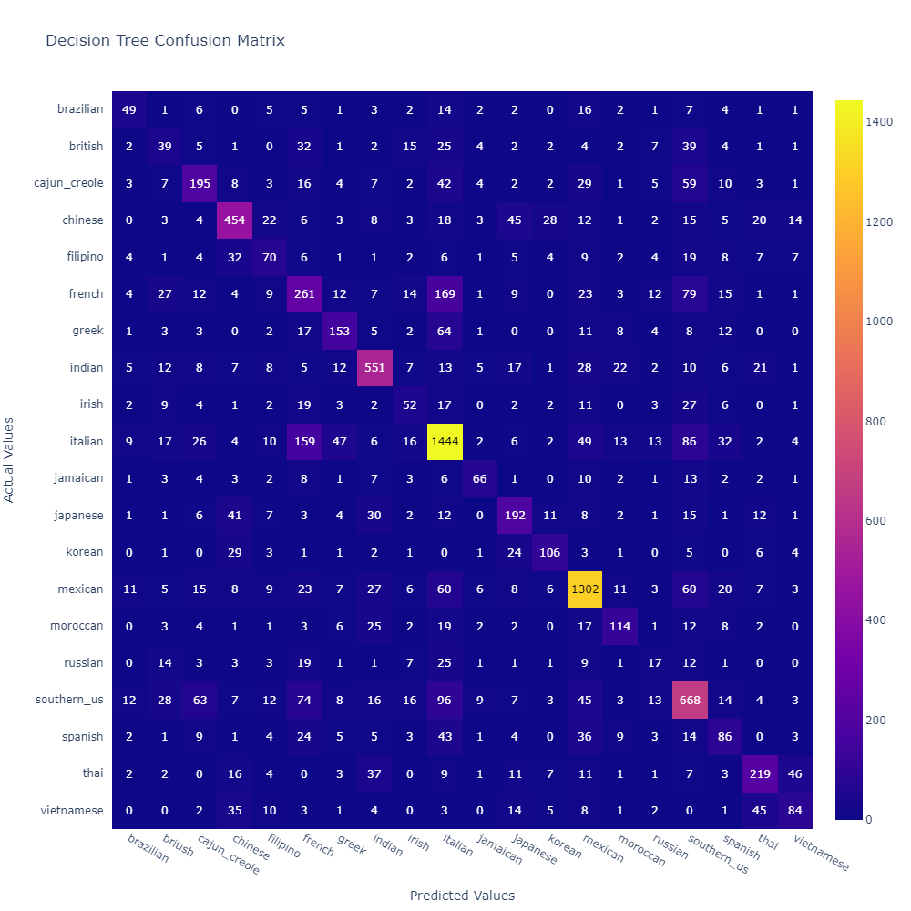
Decision Tree
Precision: 0.611
Recall: 0.616
F1 Score: 0.613
Provide the worst result as the Decision Tree model does not fit with the many feature our data have
*Precision: TP/(TP+FP)
*Recall: TP/(TP+FN)
*F1 Score: 2*recall*precision/(recall+precision)
Notes:
Now, going to the result. Here, we have the confusion matrix and metric score of each models. as expected decision tree classifier perform the worst at a precision of only 61%. Decision Tree model does not fit with the many features our data have, we expect random forest to do better.

Slide 31
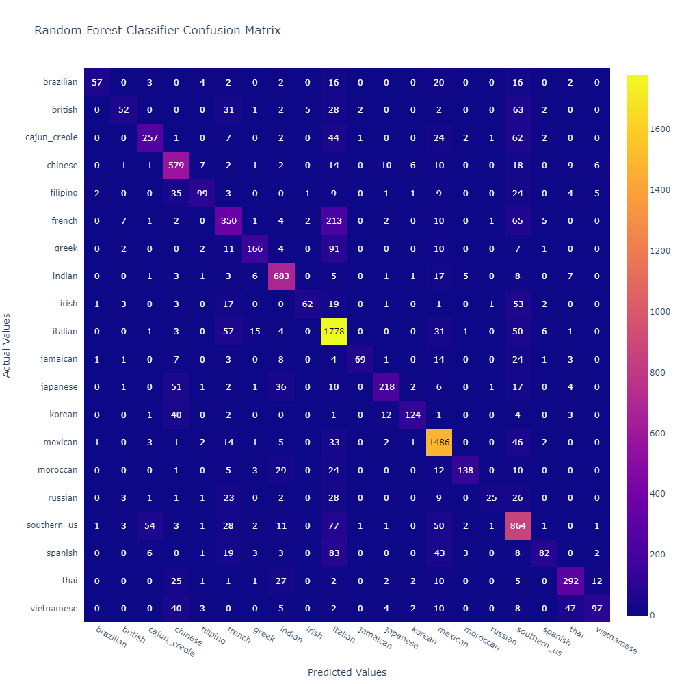
Random Forest
Precision: 0.763
Recall: 0.752
F1 Score: 0.739
Perform better than the Decision Tree, but not the best result
Notes:
And as expected, random forest classifier perform much better, having a precision of about 76%

Slide 32
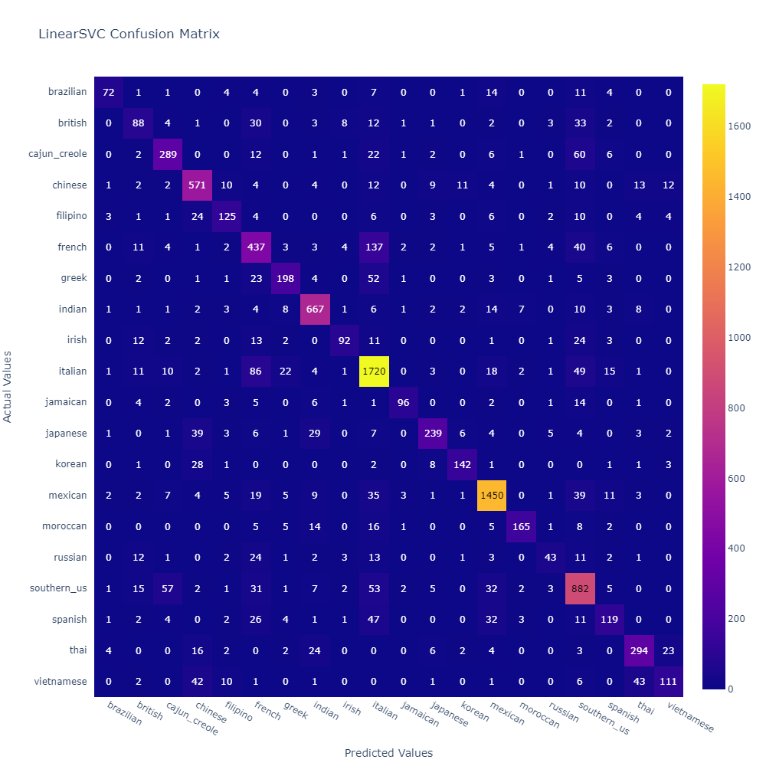
Linear SVC
Precision: 0.785
Recall: 0.784
F1 Score: 0.781
Give a better result than the previous two
Notes:
However, linear SVC perform better, giving precision of 78.5 %

Slide 33
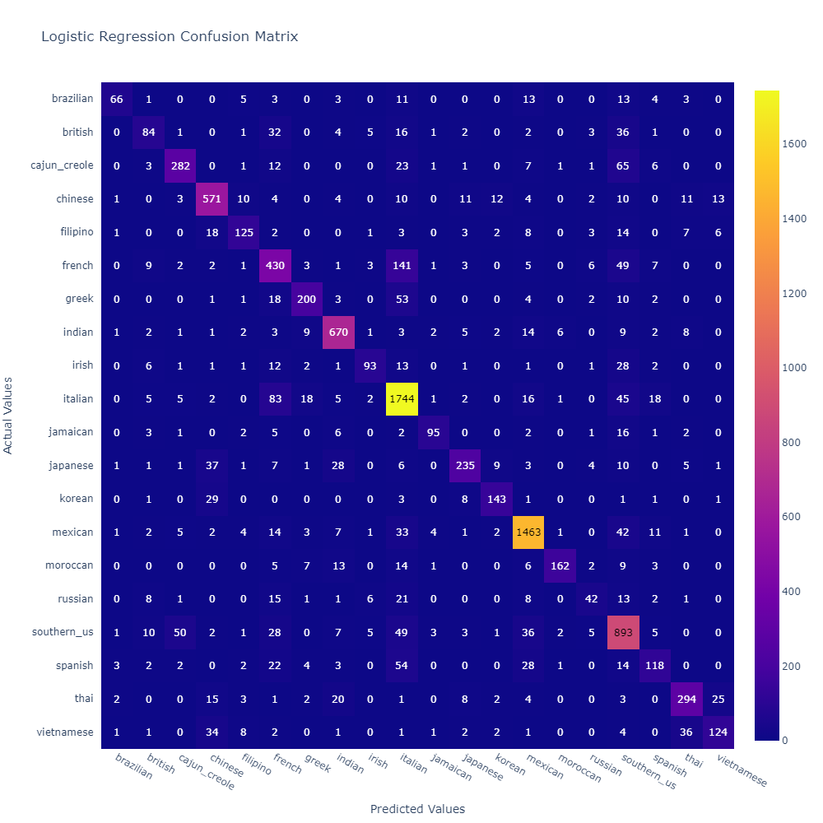
Logistic Regression
Precision: 0.788
Recall: 0.788
F1 Score: 0.784
Give the best result so far
Notes:
And logistic regression give the best result at precision and recall of 78.8%

Slide 34
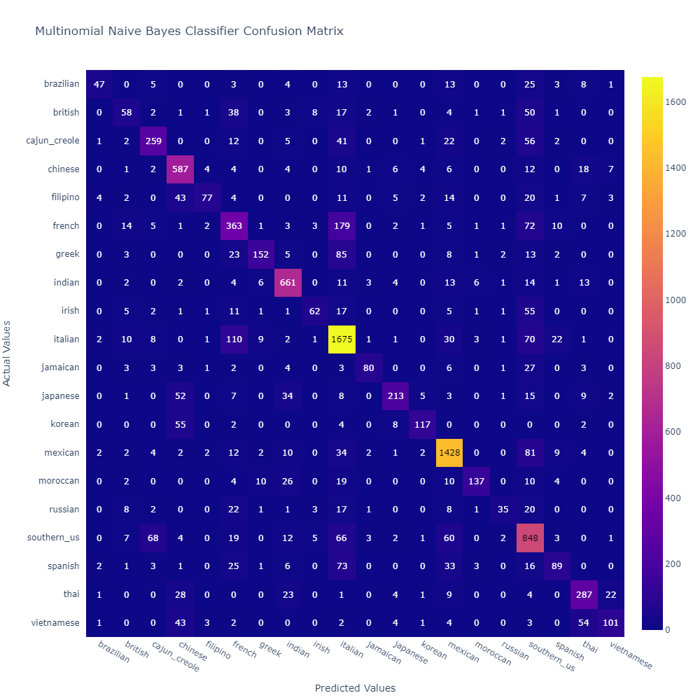
Multinomial Naive Bayes
Precision: 0.738
Recall: 0.732
F1 Score: 0.722
Give a lower precision, This is due to the fact that Naive Bayes uses a simple algorithm that assumes that all words that appear in the data are independent from each other
Notes:
Naïve bayes give a lower precision due to the simple algorithm it uses

Slide 35

Voting Classifier
Precision: 0.797
Recall: 0.796
F1 Score: 0.791
Use a combination of other model (except decision tree classifier), give the best result.
Notes:
Finally, using a combination of the other models, we get the best result with precision of 79.7%. We think this is because the models can cover each other in this way.

Slide 36
Conclusion
Using Classification, we can correctly predict the cuisine a dish belong to almost 80% of the time. It is not possible to perfectly predict with the data provided.
Overall, we manage to achieve both objective using clustering and classification.
Notes:
So in conclusion, using classification, we can correctly predict the cuisine of a dish almost 80% of the time. We have learned a lot from this project, and overall, we manage to achieve both objective using clustering and classification.

Slide 37
Vincentius Dennis Herell
Thank you for listening
-- by Vincentius Dennis Herell (U1820761L),
Zhang Han (U1923360D)
Notes:
Thank you for listening.

